Slide 1
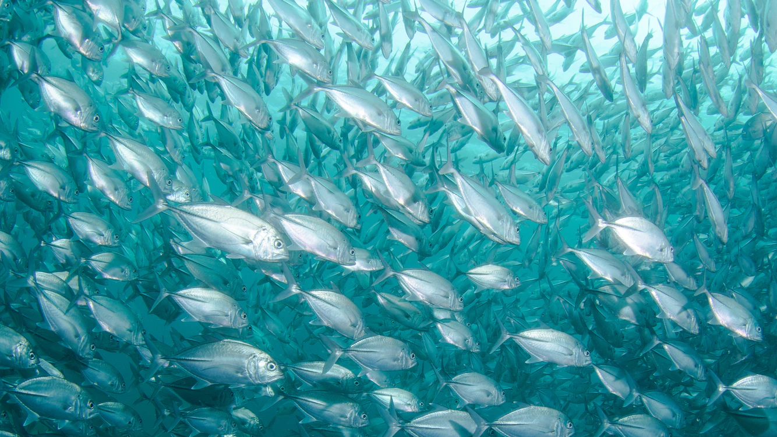
AIsda
Fish recognition using AI

Slide 2
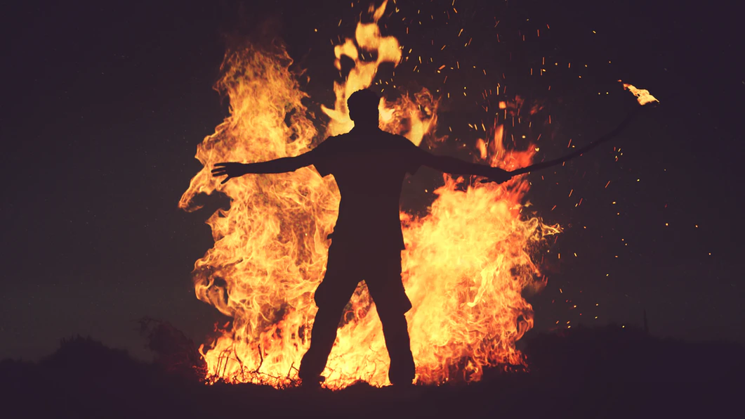
Notes:
Let me start with a bit of history.
Hundreds of thousands years ago, people have already been impacting wild animals and plants. Species dying off is not a recent phenomenon. And our capability to change landscapes and animal populations have been made so easy with technology such as fire.
It’s not coincidence that large animals have gone extinct the moment modern humans have intruded into their territory.
Woolly mammoths have been killed off by humans just thousands of years ago. It’s not coincidence that giant sloths of Australia have suddenly gone extinct at the same time modern humans stepped foot on the continent.

Slide 3
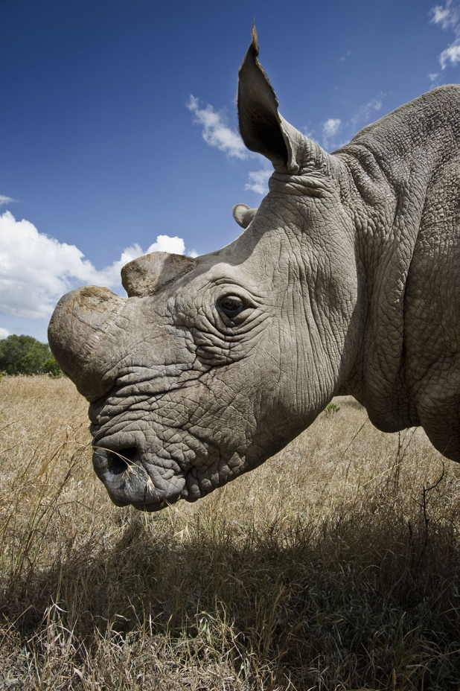
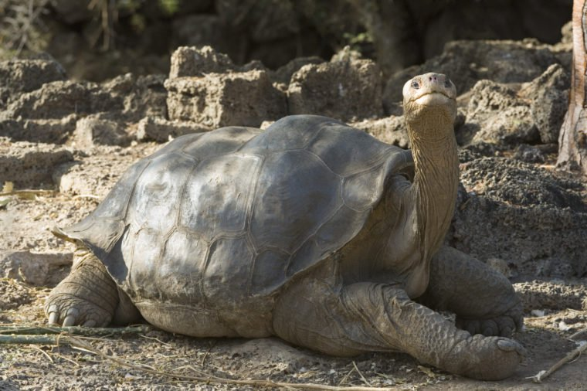
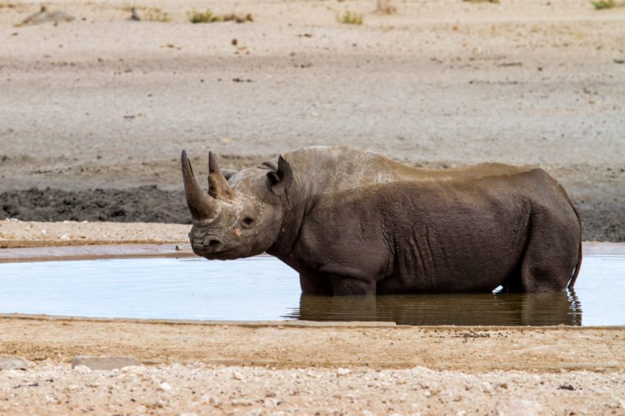
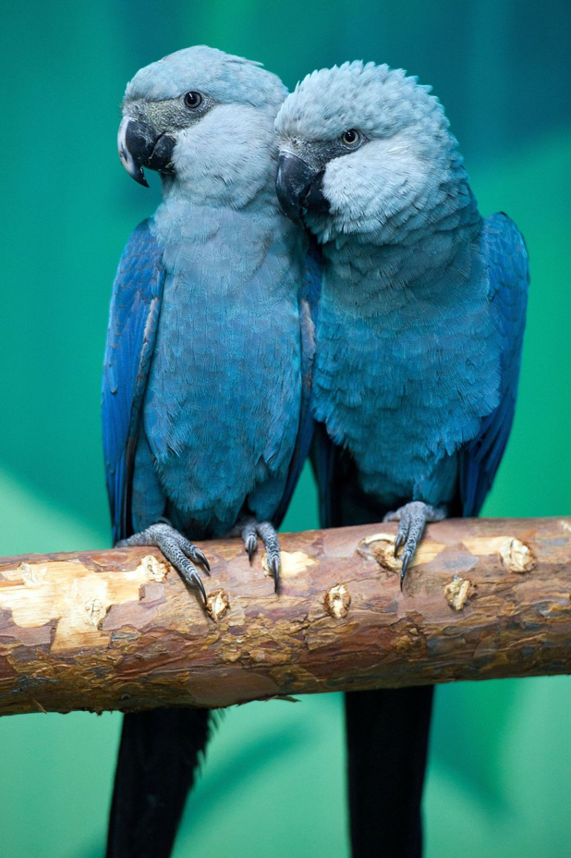
Notes:
Today, we have advanced so much that we have started a mass extinction event akin to what happened 66 million years ago.
Our machines like fishing ships, tree cutters, and guns have made killing much more efficient. Our industries and use of fossil fuels have increased greenhouse gases to the point of altering the world’s climate. We have invented a material called plastic that doesn’t degrade, goes to our oceans and traps marine life.
An estimated of 200-2000 species go extinct each year. The northern white rhinos, Western black rhinos, pinta island tortoise, and spix macaw are a few animals that have gone extinct just in the last decade.

Slide 4
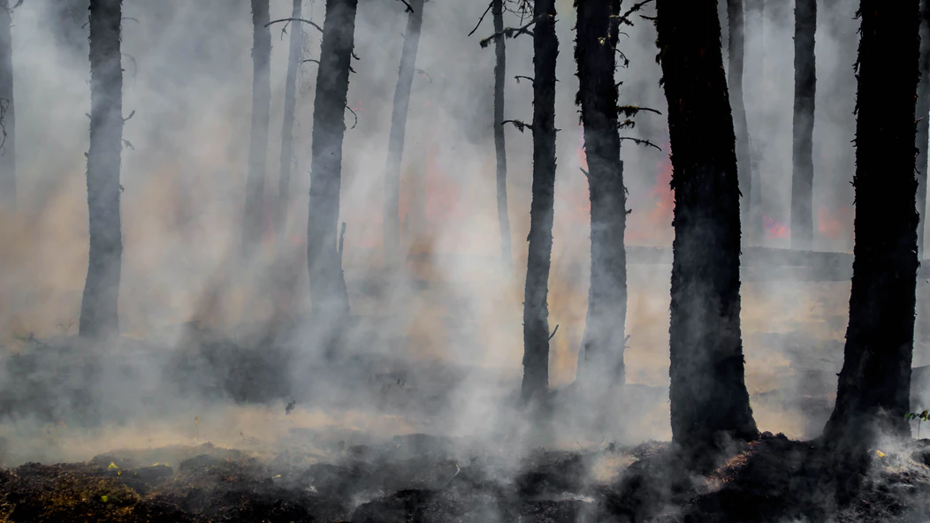
Notes:
Meanwhile, forests the area of three football fields are being cleared each second. This means 15 billion trees are cut each year.

Slide 5
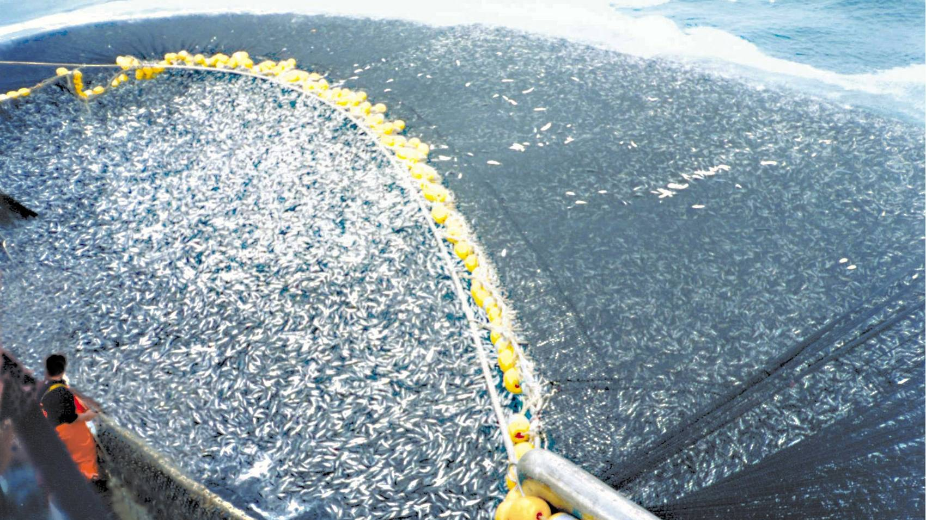
Fish Population Halved since 1970
Notes:
Fish are food sources for many species down the food chain like birds, seagulls, polar bears, and humans. In the Philippines, more than 50% of our animal protein intake comes from fish. They also play a role in enriching coral reefs with nutrients for them to thrive. Coral reefs are important habitats for marine animals. Coral reefs in the Philippines in particular have one of the highest biodiversity in the world.
However, fish populations are now declining due to overfishing and climate change. Their numbers have already halved since 1970. It is thus important that we restore and conserve fish populations. We don’t want to tip the balance of ecosystems on which we rely on.
http://www.fao.org/fi/oldsite/FCP/en/phl/profile.htm
https://www.qm.qld.gov.au/microsites/biodiscovery/05human-impact/importance-of-coral-reefs.html

Slide 6
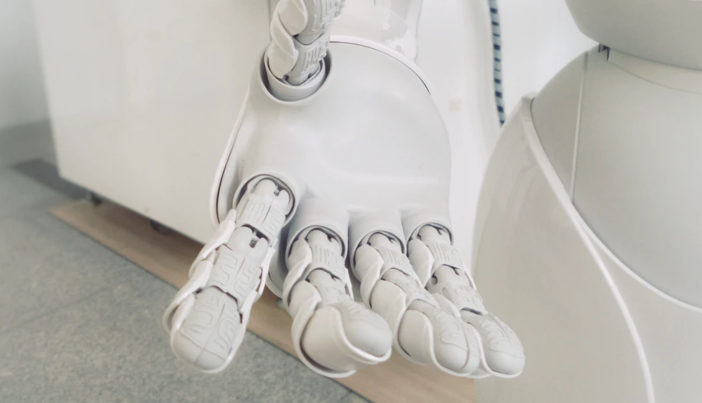
How Can AI Help?
Notes:
While fishes in the oceans have been declining, AI research especially in the fields of deep learning have been gaining traction in the past few years. Image recognition, in particular, has seen a leap in performance in 2012 when Geoffrey Hinton and his team unveiled a deep convolutional network called AlexNet. In 2015, Microsoft’s AI beat human in object identification.
Our question is how can we use these advancing AI technologies help in conserving fish in the oceans?

Slide 7
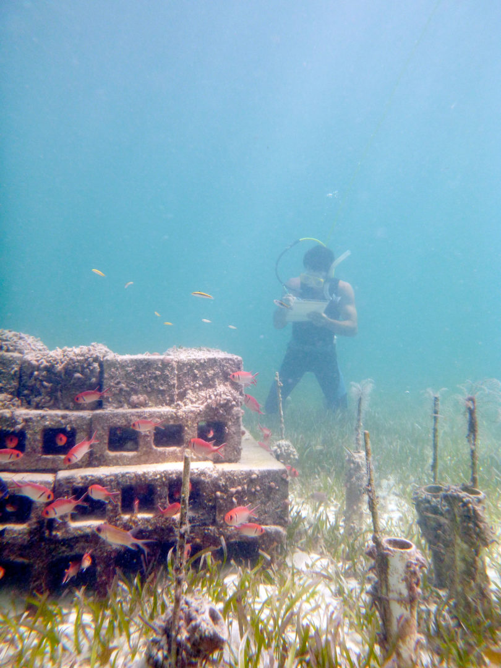
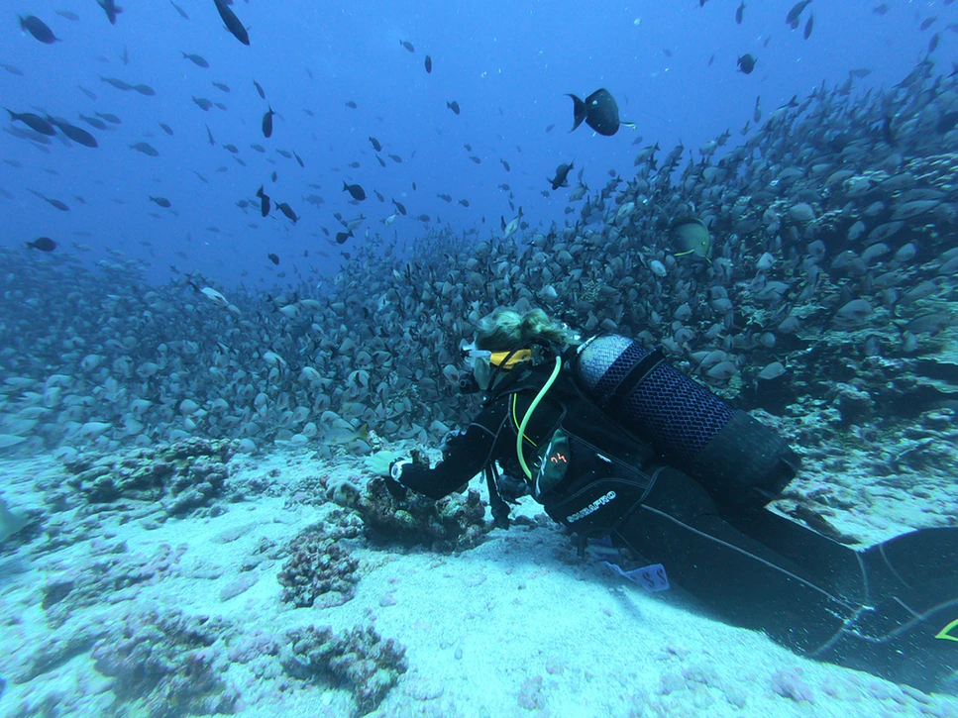
Notes:
There are over 30,000 fish species identified so far. Current auditing of fish entails divers and manually auditing fish. With the sheer number of fishes and large swaths of coral reefs, manual auditing is not scalable. If we can train an AI to identify and count fish from photos and videos, then we can automate auditing from underwater cameras. We can expand the scope of audit spatially and in time. This will not replace manual audits by divers but will rather augment them.

Slide 8
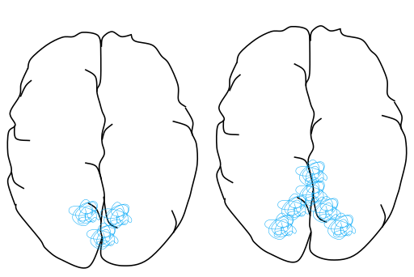
Visual Cortex
Notes:
The state of the art in image recognition is a deep learning architecture called convolutional neural nets or CNN.
This architecture is most apt for our problem of fish recognition.
CNN was inspired by the brain’s visual system in the brain region called the visual cortex. Light passes through our eyes and focused into our retina which then converts those signals into electrochemical signals that our brain can process. Each type of signal stimulates certain neurons. For example, signals for circles stimulate a set of neurons, while signals for lines simulate another set of neurons. These neurons are models of the world imprinted in our brain. So these models for various features in the image like lines and circles overlap with each other until you form the entire image. That is what inspired the CNN architecture.

Slide 9
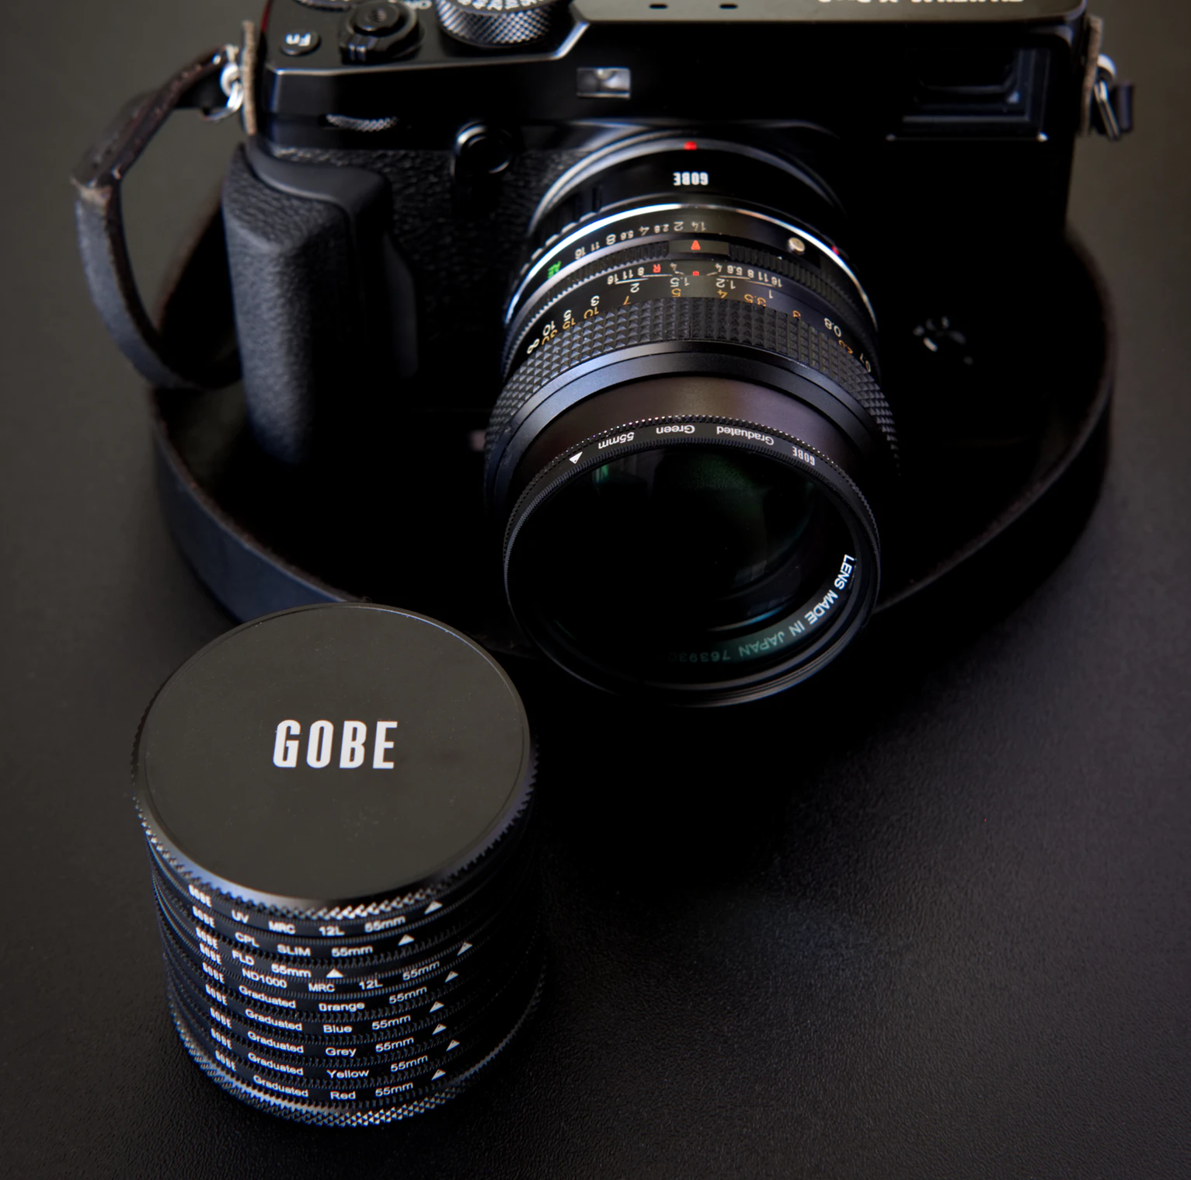
Notes:
CNN is an automatic way of creating these “filters” very much like polarized filters in a camera. The objective is to extract features from the image such as squares, circles, lines, and squiggles that when taken together serve as a DNA of the image.

Slide 10
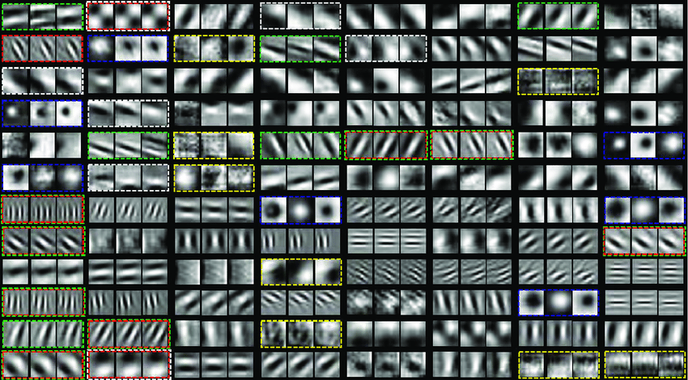
Notes:
Here is an example of the features extracted from an image. Each box is a filter that filters for a specific feature.
Some filters find circles, some find lines and others boxes.

Slide 11

CNN
Notes:
Here’s an illustration of a CNN architecture. The input is an image. The output is the label of that image, which in this case is a robot. The filters are each of the boxes in between the input and the output. The way this works is an image passes through many filters that selects certain features. These features cumulatively make up a feature map, which again is the DNA of the image. We can then use this DNA to identify the image.
Initially, the filters are random and no feature are extracted from an image. But by showing the model many examples of images, the CNN automatically finds the optimal filters that will best identify objects from those images.
Once we have a trained model, the next question is how do we find an object in an image?

Slide 12
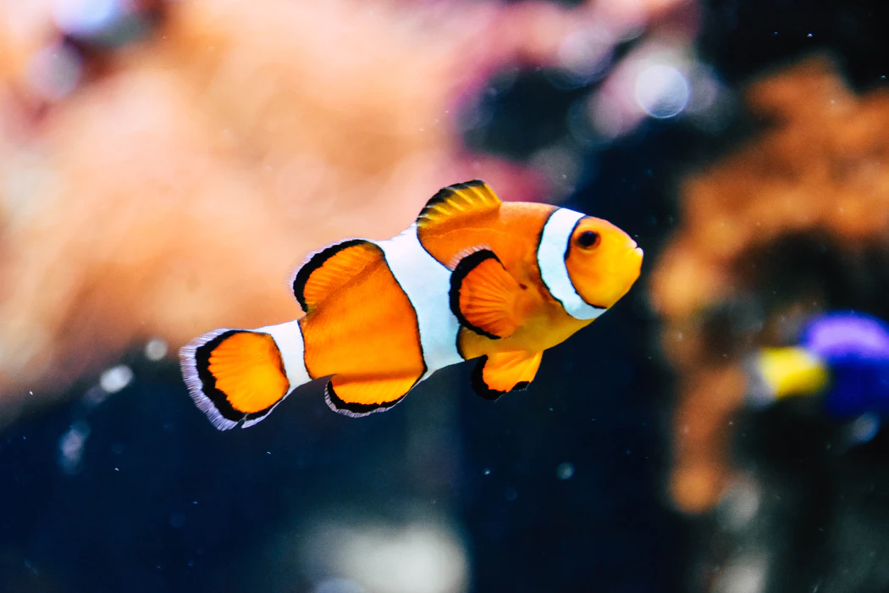
Clown Fish
Notes:
ANIMATE THIS
One way to do it is to have a box scan an image from left to right and then top down.
We can then run each scan in our CNN model and try to predict what’s in the image.
Most of the time, there will be no object in the image, but we will keep scanning until an object fits inside the box.
The problem with this approach is it’s a brute force approach. We will use a lot of computation scanning and running each scan in our CNN model.

Slide 13
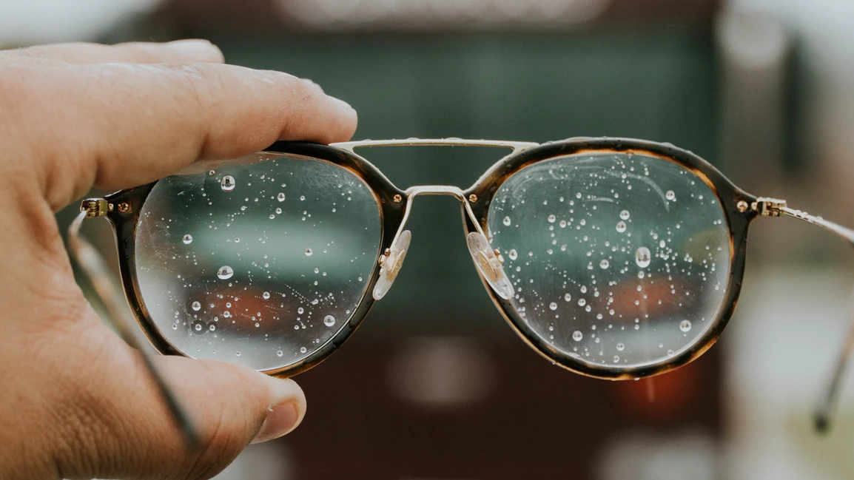
#YOLO
Notes:
A new, faster approach is YOLO. YOLO in this case doesn’t stand for You Only Live Once but rather You Only Look Once.
Published in 2015, this is hundreds of times faster than the brute force approach. Because the model literally looks at all potential boxes once.
Many improvements have been incorporated in the model ever since. In this project, we used the YOLO v2 algorithm published in December 2016.

Slide 14
Notes:
ANIMATE THIS
First, the image is divided into a grid, shown here by the color green. In our case, we divided the image into a 3X3 grid or 9 cells. For each cell, the model predicts n bounding boxes. In our simplified example, we predicted two bounding boxes for each cell.
Finally, the model predicts the object in each bounding box with a certain confidence.

Slide 15
box center x
box center y
box width
box height
P(object exists)
P(class 1)
P(class 2)
...
YOLO
Notes:
Training
In detail, YOLO calculates predicts the x and y coordinates of the center, the width and height of each bounding box, and the probability that an object exists in a box. Finally, if an object exists in the box, the model predicts the probability the object belongs to a class.
All in all, if we follow the math, the model is trained to predict five bounding box properties plus the number of classes in our dataset.

Slide 16
Clown Fish
Notes:
The confidence of a box is the likelihood it contains an object. If it exceeds a threshold, we retain that bounding box and we identify the object.
Because you only look once, YOLO is hundreds of times faster than competing models and can identify thousands of objects in real time. This makes it perfect for applications that require counting many objects in an image over long periods of time.
In our project, we wanted to see a proof of concept of using YOLO for quick fish counting and identification.
For a prototype, we trained a YOLO model to predict three kinds of fish swimming in an aquarium.

Slide 17
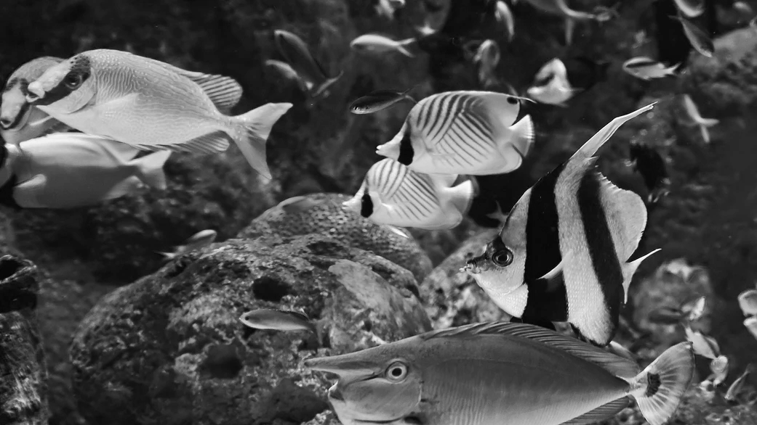
AIsda
Notes:
Presenting AIsda

Slide 18
AIsda
Train Images
Test
Data augmentation
Bounding boxes and labels
Notes:
As a proof of concept, we used a footage of fishes we captured in Hong Kong Ocean Park.
Then we split the footage into training and test set. The first 75% of footage was used for training, while the remaining 25% was used for test.
To improve performance, we needed to increase the number of training data. We doubled training data by adding flipped images. All in all, we used 226 images for training. Each fish in each image was manually annotated with their bounding box coordinates, dimensions, and fish species.

Slide 19
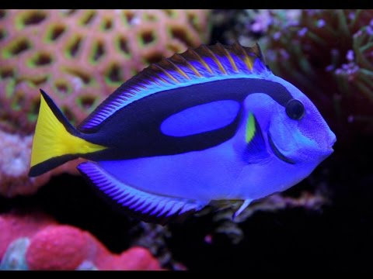
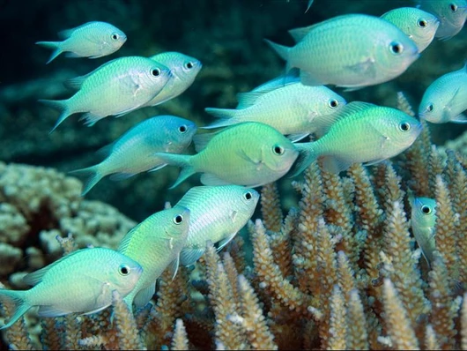
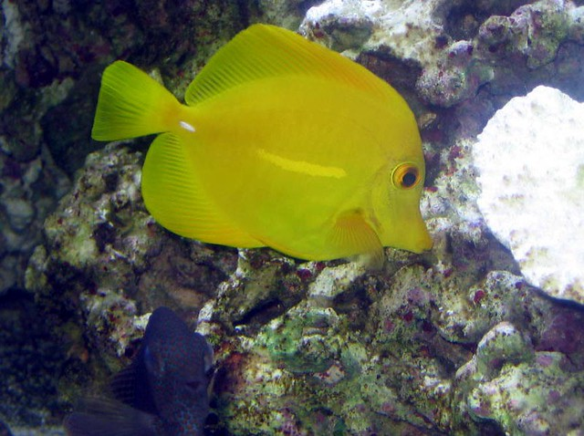
Blue tang surgeonfish
Damselfish
Butterfly fish
Notes:
We selected only three species for training: the blue tang surgeonfish, damselfish, and butterfly fish

Slide 20
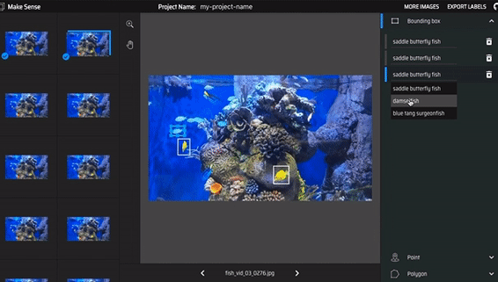
226 images were annotated using makesense.ai
Notes:
With the help of volunteers, each image in the training set was manually annotated using the online tool makesense.ai.
The output of this tool was an XML file for each image that contains the bounding box coordinates, width, height, and fish species.
A total of 715 butterfly fish, 629 blue tang surgeonfish, 2137 damselfish were annotated in 226 images.

Slide 22
Volunteers

